Slide 1
Software Integration
Lecturer: Ngo Huy Bien
Software Engineering Department
Faculty of Information Technology
VNUHCM - University of Science
Ho Chi Minh City, Vietnam
nhbien@fit.hcmus.edu.vn

Slide 2

References
Matjaz B. Juric et al. (2007). SOA Approach to Integration. Packt Publishing.
Gregor Hohpe and Bobby Woolf (2003). Enterprise Integration Patterns: Designing, Building, and Deploying Messaging Solutions. Addison-Wesley Professional.

Slide 3
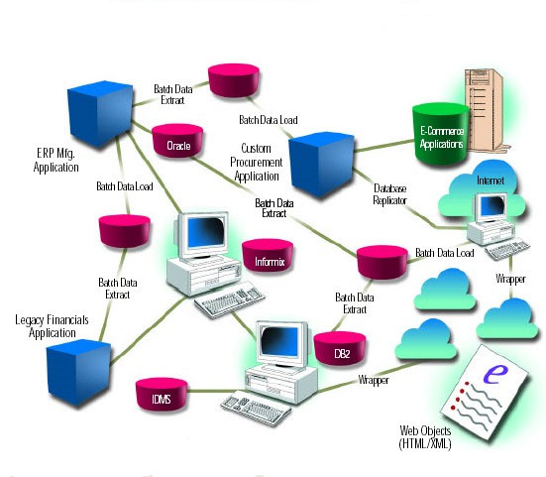
Legacy Systems Architecture [1]
There were no common methods used that share information in real time among different system.
It was not secure and safe
Applications were tightly coupled with each other.
Maintenance cost was high.

Slide 4
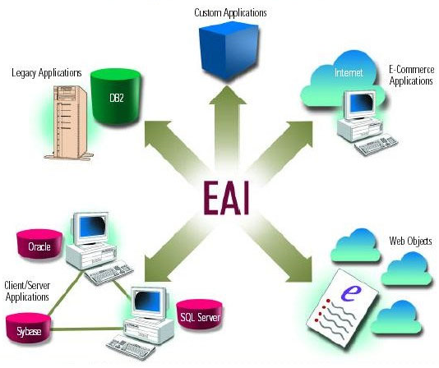
Enterprise Application Integration
EAI (enterprise application integration) is a business computing term for the plans, methods, and tools aimed at modernizing, consolidating, and coordinating the computer applications in an enterprise.
Problems:
Real-time Integration
Secure and Scalable
Lower Total Cost of Ownership
Less development and support cost
Faster Build

Slide 5
Sound EIA Benefits
Reusability
Encapsulation
Distribution
Partitioning
Scalability
Improved Reliability
Manageability
Increased consistency and flexibility
Independent development
Composition

Slide 6


Slide 7

Types of Integration

Slide 8
Types of Integration
Integration architecture is usually built systematically in several layers.
The idea is to break the problem into several smaller problems and solve each sub-problem step by step.
We usually start building the integration architecture at the lowest layer and climb gradually.

Slide 9
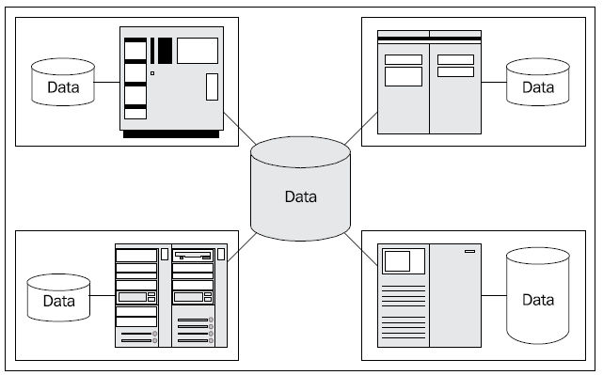
Data-Level Integration
Data-level integration is an integration type in which the same data is shared between different applications.
It can cause corruption of application data
It’s hard to understand data of other applications

Slide 10
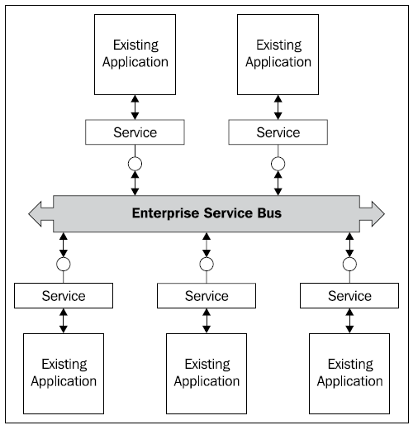
Application Integration
Application integration is an integration type in which applications that expose their functionality through APIs enable access to the functionality in a programmatic way.
Application integration focuses on sharing functionality—business logic; and not just pure data as in data-level integration.
Requires to learn APIs
Different technologies

Slide 11
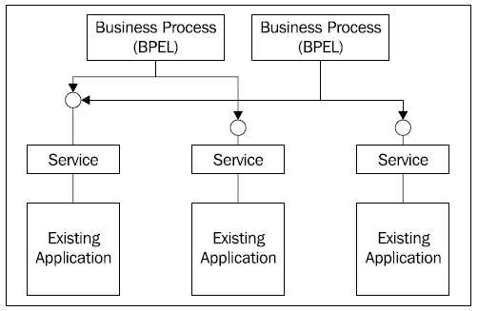
Business Process Integration
Business process integration is an integration type in which the information system interfaces are based on a new designed architecture.
However, the functionalities are not re-implemented; rather, they use existing applications.
Those existing applications are remodeled in a way that they expose the functionality of the business process tier and fit into the modern application architecture.
Finally, the different pieces are glued together, usually by using a business process modeling and execution language, such as BPEL (Business Process Execution Language).

Slide 12
Presentation Integration
Presentation integration is a step in which we define and implement a common user interface—usually a portal—for the business-method-level integrated information system.
The user interface will provide the illusion of a new system, and add the missing piece to the multi-tier integration architecture.

Slide 13
Business-to-Business Integration
Business-to-business (B2B) integration, or e-business is an integration type in which one business is responsible for on-demand processing of requests of the other.
The prerequisite for efficient e-business or B2B integration is an integrated enterprise information system, possibly on the business-process level, which must be at both ends.

Slide 14
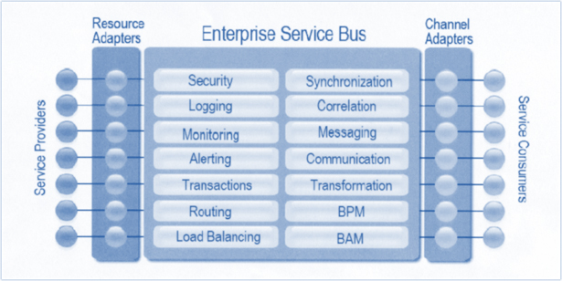
Integration Infrastructure

Slide 15
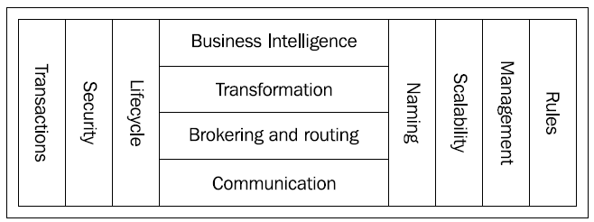
Integration Infrastructure (I)
The integration infrastructure should provide ways to control the lifecycle of all applications involved.
It should enable existing applications to be replaced one by one or even by parts without having influence on the other applications in the integrated system.
The primary responsibility of the communication service is to provide the abstraction for communication details.

Slide 16
Integration Infrastructure (II)
The brokering and routing layer takes care of implementing the technical side of integration. No matter what type of integration we use, this layer should adapt the communication between applications in such way that all participating applications will be able to interoperate.
The transformation layer takes care of transformation of data structures, their representations, and technologies.
The business intelligence layer is responsible for presenting the high-level interface to access business information to other applications and to the users. The business-intelligence layer presents data to users in an understandable form.

Slide 17
Integration Infrastructure (III)
The transactional semantics means that any operation performed on one or more applications that causes a state change or changes to permanent data has to be performed as operation that guarantees that the consistency of the system is preserved.
The horizontal services require specific rules for performing communication, brokering, routing, and business-intelligence tasks. These rules should not be hard-coded into applications, but should rather be declaratively specified inside the integration infrastructure.
A unified naming service will allow for the implementation of location transparency and will enable the replacement of one resource with another if this is required.

Slide 19

Integration Technologies

Slide 20
Integration Technologies
Comprehensive enterprise-wide integration infrastructure usually requires more than one technology.
When selecting and mixing different technologies, we have to focus on their interoperability.
Technologies used for integration are often referred to as middleware.
Middleware is system services software that executes between the operating system layer and the application layer and provides services.

Slide 21
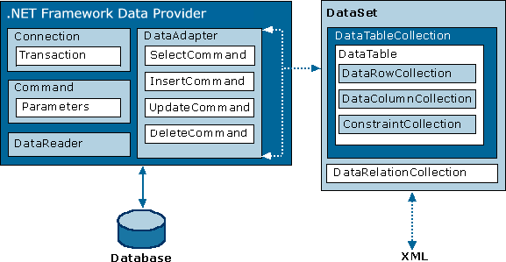
Database Access Technologies
Database access technologies are frameworks that provide access to the database through an abstraction layer, which enables us to change the actual DBMS without modifying the application source code.

Slide 22
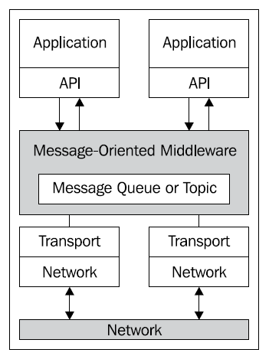
Message-Oriented Middleware
Message-oriented middleware (MOM) is a client/server infrastructure that enables and increases interoperability, flexibility, and portability of applications.
It enables communication between applications over distributed and heterogeneous platforms.

Slide 23
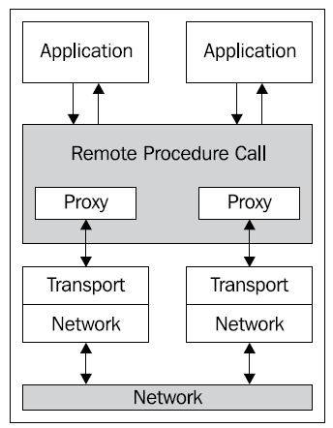
Remote Procedure Calls
Remote Procedure Invocation is an integration style that achieves Application to Application (A2A) integration by allowing one application to invoke a function published by a second application. The function in application two, appears as a local function to application one.
The underlying mechanism which generates this transparency is based upon providing a function stub to application one, that when called accesses a middleware layer which transports the call and its associated data to application two.
The generation of stub functions is typically automated, with tools consuming an interface description of the target function and creating the stub veneer.
RPC promotes synchronous, request-reply communication (sometimes referred to as "call/wait"), which blocks the client until the server fulfills its requests.

Slide 24
Transaction Processing Monitors
Transaction processing (TP) monitors are middleware technology based on the concept of transactions.
They monitor and coordinate transactions among different resources.
They provide performance management with load balancing and resource pooling techniques.
They also provide security management where they enable or disable access of clients to certain data and resources.
They are predecessors of today's application servers.

Slide 25
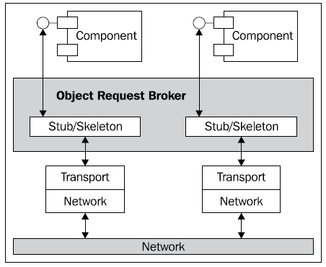
Object Request Brokers
Object request brokers (ORBs) are a middleware technology that manages and supports the communication between distributed objects or components.
Java RMI and RMI-IIOP
Microsoft COM/DCOM/COM+/.NET Remoting/WCF

Slide 26
Web Services
Web service is a technology that fulfills the universal interoperability promise between applications running on disparate platforms.
The fundamental specifications that web services are based on are
SOAP (Simple Object Access Protocol),
WSDL (Web Services Description Language), and
UDDI (Universal Description, Discovery, and Integration).
SOAP, WSDL, and UDDI are XML based, making web services protocol messages and descriptions human readable.

Slide 27
Application Servers
The application servers are software platforms.
A software platform is a combination of software technologies necessary to run applications.
The software platforms define the infrastructure of all applications developed and executed on them.
In the majority of application servers, we can find support for web services, ORBs, MOM, transaction management, security, load balancing, and resource management.

Slide 28
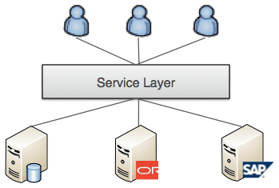
API Layer
An API layer (or Service Layer) provides a set of APIs to access data and/or functionality.
Typically implemented using REST or SOAP services over HTTP, it provides decoupling of backend systems and applications from the clients that access them.
https://blogs.mulesoft.com/dev/mule-dev/esb-or-not-to-esb-revisited-part-3/

Slide 29
Enterprise Service Buses
An Enterprise Service Bus (ESB) is a software infrastructure acting as an intermediary layer of middleware that addresses the extended requirements that usually cannot be fulfilled by web services, such as integration between web services and other middleware technologies and products, higher level of dependency, robustness, and security, management, and control of services and their communication.
An ESB can act as a mediator between different, often incompatible, protocols and middleware products.
Read more: David Chappell (2004). Enterprise Service Bus. O'Reilly Media.

Slide 30
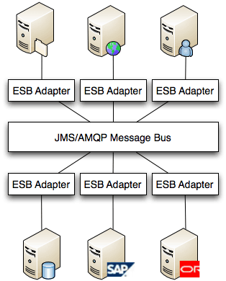
ESB is an Architecture
The ‘bus’ concept decouples applications from each other, this is usually achieved using a messaging server like JMS or AMQP.
The data that travels on the bus is a canonical format and is almost always XML.
There is an ‘Adapter’ between the application and the bus that marshals data between the two
https://blogs.mulesoft.com/dev/mule-dev/esb-or-not-to-esb-revisited-part-1/

Slide 31
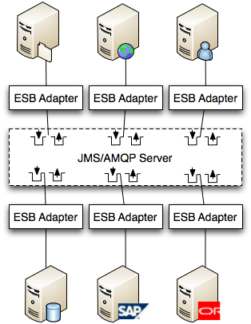
ESB
In reality, there is a messaging server such as JMS, AMQP, Tibco RV or WebsphereMQ used as the communication channel.
The messaging server is responsible for delivering the messages between application adapters.
So in truth, the Bus is real as the set of the queue through which data can be sent and received.
The ESB Adapter is really where a lot of the magic happens.
This is where data marshaling, transformation, security, transaction management and mediation is handled.

Slide 32
Development with ESB
Defining canonical message format. This is not an easy process since you need to define a message that suits the different needs of the applications you are integrating. Typically there is a common section for all applications and then additional payloads or attachments to allow for varied content.
Defining adapter architecture. Given that you create an adapter for each application, you’ll want to make it as standard as possible so that it can be stamped out quickly for new applications. Typically the adapter takes care of data translation, validation, message routing, etc.
There is a learning curve for developers since ESB have new concepts such as endpoints, connectors, and components that are not always familiar. Also, the ESB architecture is typically asynchronous and uses messaging for communication, many developers will not have thought about systems in this way.

Slide 34
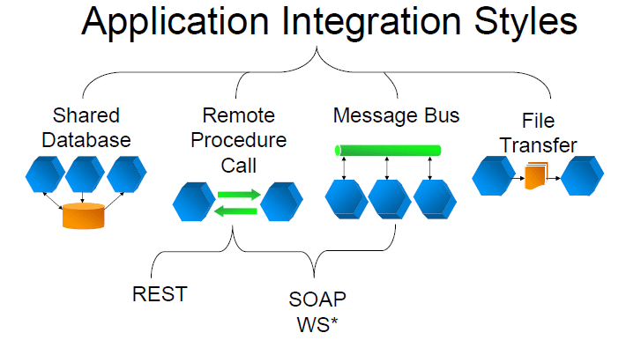
Integration Styles [2]

Slide 35
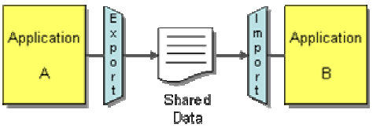
File Transfer
An enterprise has multiple applications that are being built independently, with different languages and platforms.
How can I integrate multiple applications so that they work together and can exchange information?
File Transfer — Have each application produce files of shared data for others to consume, and consume files that others have produced.

Slide 36
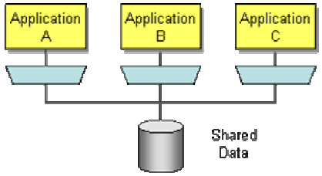
Shared Database
An enterprise has multiple applications that are being built independently, with different languages and platforms. The enterprise needs information to be shared rapidly and consistently.
How can I integrate multiple applications so that they work together and can exchange information?
Shared Database — Have the applications store the data they wish to share in a common database.

Slide 37
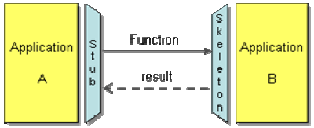
Remote Procedure Invocation
An enterprise has multiple applications that are being built independently, with different languages and platforms. The enterprise needs to share data and processes in a responsive way.
How can I integrate multiple applications so that they work together and can exchange information?
File Transfer and Shared Database enable applications to share their data, but not their functionality.
Remote Procedure Invocation — Have each application expose some of its procedures so that they can be invoked remotely, and have applications invoke those to run behavior and exchange data.

Slide 38
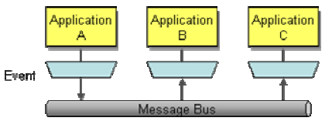
Message Bus
An enterprise has multiple applications that are being built independently, with different languages and platforms. The enterprise needs to share data and processes in a responsive way.
How can I integrate multiple applications so that they work together and can exchange information?
Remote Procedure Invocation enables applications to share functionality, but tightly couples them in the process.
Messaging — Have each application connect to a common messaging system, and exchange data and invoke behavior using messages.

Slide 40

Messaging

Slide 41
Messaging
Messaging is a technology that enables high-speed, asynchronous, program-to-program communication with reliable delivery.
Messages are packets of data that are sent. The message itself is simply some sort of data structure—such as a string, a byte array, a record, or an object.
Channels, also known as queues, are logical pathways that connect the programs and convey messages. A channel behaves like a collection or array of messages, but one that is magically shared across multiple computers and can be used concurrently by multiple applications.
A sender or producer is a program that sends a message by writing the message to a channel.
A receiver or consumer is a program that receives a message by reading (and deleting) it from a channel.

Slide 42
Messaging System
Messaging system is a separate software system providing messaging capabilities.
An administrator must configure the messaging system with the channels that define the paths of communication between the applications.
The messaging system then coordinates and manages the sending and receiving of messages.

Slide 43
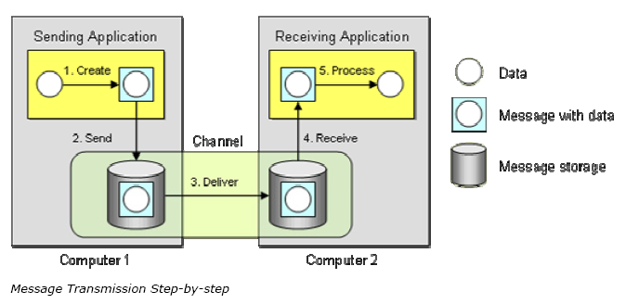
Message Transmission
A message is transmitted in five steps: 1. Create — The sender creates the message and populates it with data. 2. Send — The sender adds the message to a channel. 3. Deliver — The messaging system moves the message from the sender’s computer to the receiver’s computer, making it available to the receiver. 4. Receive — The receiver reads the message from the channel. 5. Process — The receiver extracts the data from the message.

Slide 44
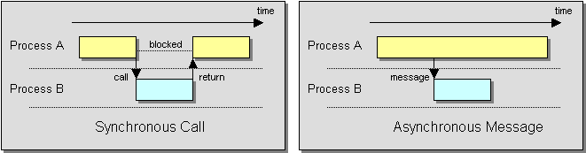
Thinking Asynchronously
Send and forget
Store and forward

Slide 45
Why Use Messaging?
Remote Communication
Platform/Language Integration
Asynchronous Communication
Throttling
Reliable Communication
Disconnected Operation

Slide 46
Challenges of Asynchronous Messaging
Complex programming model
Sequence issues
Synchronous scenarios
Performance
Limited platform support
Vendor lock-in

Slide 47
Commercial Messaging Systems
Operating Systems: Microsoft Message Queuing (MSMQ) service software, Oracle AQ
Application Servers: Java Messaging Service (JMS)
EAI Suites: IBM WebSphere MQ, Microsoft BizTalk, TIBCO, WebMethods, SeeBeyond, Vitria, CrossWorlds

Slide 48
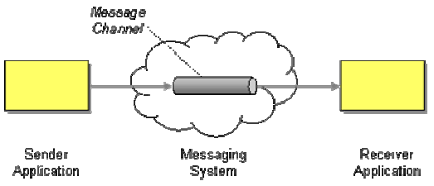
Message Channel (I)
An enterprise has two separate applications that need to communicate, preferably by using Messaging.
How does one application communicate with another using messaging?
Connect the applications using a Message Channel, where one application writes information to the channel and the other one reads that information from the channel.

Slide 49
Message Channel (II)
Channels are logical addresses in the messaging system.
These addresses depend on the implementation of the messaging system. In most cases channels are referenced by an alphanumeric name, such as MyChannel.
There are two different kinds of message channels, Point-to-Point Channels and Publish-Subscribe Channels.

Slide 50
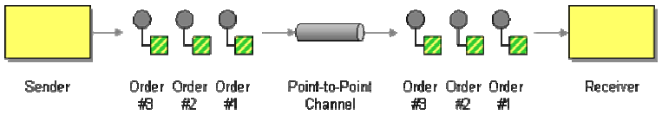
Point-to-Point Channel
An application is using Messaging to make remote procedure calls (RPC’s) or transfer documents.
How can the caller be sure that exactly one receiver will receive the document or perform the call?
Send the message on a Point-to-Point Channel, which ensures that only one receiver will receive a particular message.

Slide 51
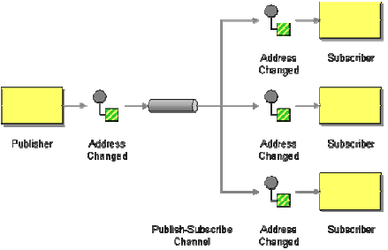
Publish-Subscribe Channel
An application is using Messaging to announce events.
How can the sender broadcast an event to all interested receivers?
Send the event on a Publish-Subscribe Channel, which delivers a copy of a particular event to each receiver.

Slide 52
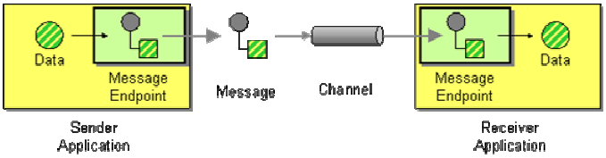
Message Endpoint
Applications are communicating by sending Messages to each other via Message Channels.
The application and the messaging system are two separate sets of software.
They must have a way to connect and work together.
How does an application connect to a messaging channel to send and receive messages?
Connect an application to a messaging channel using a Message Endpoint, a client of the messaging system that the application can then use to send or receive messages.

Slide 53
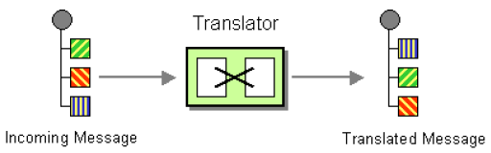
Message Translator
How can systems using different data formats communicate with each other using messaging?
Use a special filter, a Message Translator, between other filters or applications to translate one data format into another.
The Message Translator is the messaging equivalent of the GoF Adapter pattern.

Slide 54
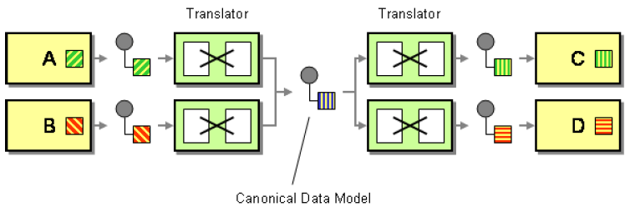
Canonical Data Model
I am designing several applications to work together through Messaging. Each application has its own internal data format.
How can you minimize dependencies when integrating applications that use different data formats?
Design a Canonical Data Model that is independent from any specific application. Require each application to produce and consume messages in this common format.

Slide 55
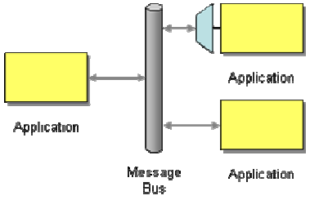
Message Bus (I)
An enterprise contains several existing systems that must be able to share data and operate in a unified manner in response to a set of common business requests.
What is an architecture that enables separate applications to work together, but in a decoupled fashion such that applications can be easily added or removed without affecting the others?
Structure the connecting middleware between these applications as a Message Bus that enables them to work together using messaging.

Slide 56
Message Bus (II)
A Message Bus is a combination of a common data model, a common command set, and a messaging infrastructure to allow different systems to communicate through a shared set of interfaces.
A Message Bus requires that all of the applications using the bus use the same Canonical Data Model.
Applications adding messages to the bus may need to depend on Message Routers to route the messages to the appropriate final destinations.
Applications not designed to interface with a messaging system may require Channel Adapters and Service Activators.

Slide 57

Thank You for Your Time

